Slide 1

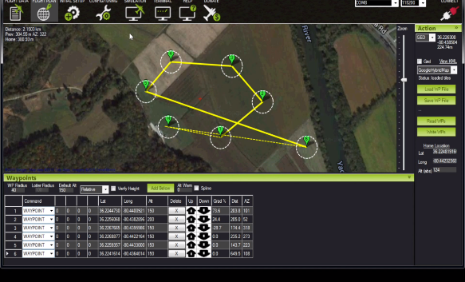
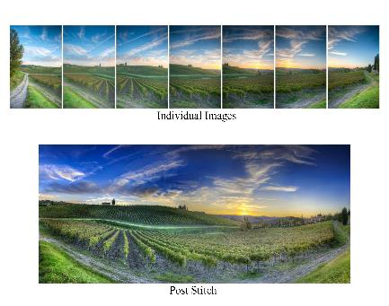
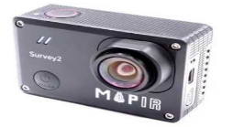
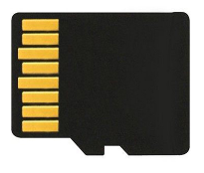



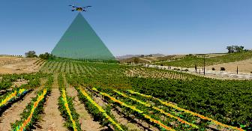


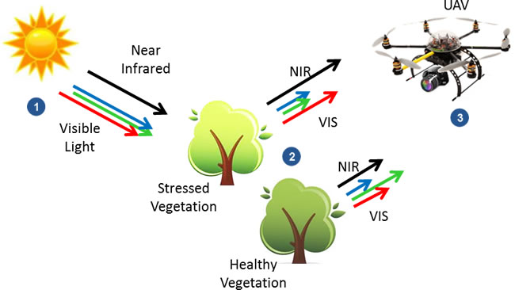
Autonomously Detecting Pierce’s Disease
Introduction
Team Sub Divisions
The Unmanned Aerial Vehicle (UAV) Engineering Service Learning Team is working to design and implement UAV systems that will provide local, small-scale farmers with an efficient method of disease detection and crop management through precision techniques. By designing an autonomous aerial device and a post-flight image analysis program from inexpensive parts and materials, the UAV team hopes to reduce the cost to the farmer who wishes to improve agricultural techniques to detect and stop the spread of disease in perennial crops. This team works in cooperation with the Merced County Cooperative Extension (MCCE).
The UAV team is composed of two sub-teams:
Platform Team: Implements a fully functional flight interface that provides autonomy. They also assemble and mount equipment to be used by the UAVs.
Imaging Team: Provides solutions via imaging analysis. The imaging team assembles images taken from the drone into one big image. They also use NDVI processing to highlight areas of crops that might contain diseases.
Design
Route Planning
Image Capture
Autonomous Flight
External Memory
Image Stitching
Image Processing
Future Plans
Our main objective is to have an Unmanned Aerial System with minimal user input that can be used as an efficient method of disease detection. We plan on having our final delivered product out for use and to be maintained in part by the Team along with the cooperation of the University of California MCCE. We hope to aid farmers by providing low cost precision techniques to reduce the cost of crop loss by means of early detection for disease through image analysis.
engsl@ucmerced.edu
engineeringservicelearning.ucmerced.edu

Slide 2

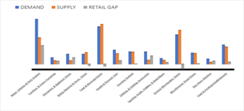
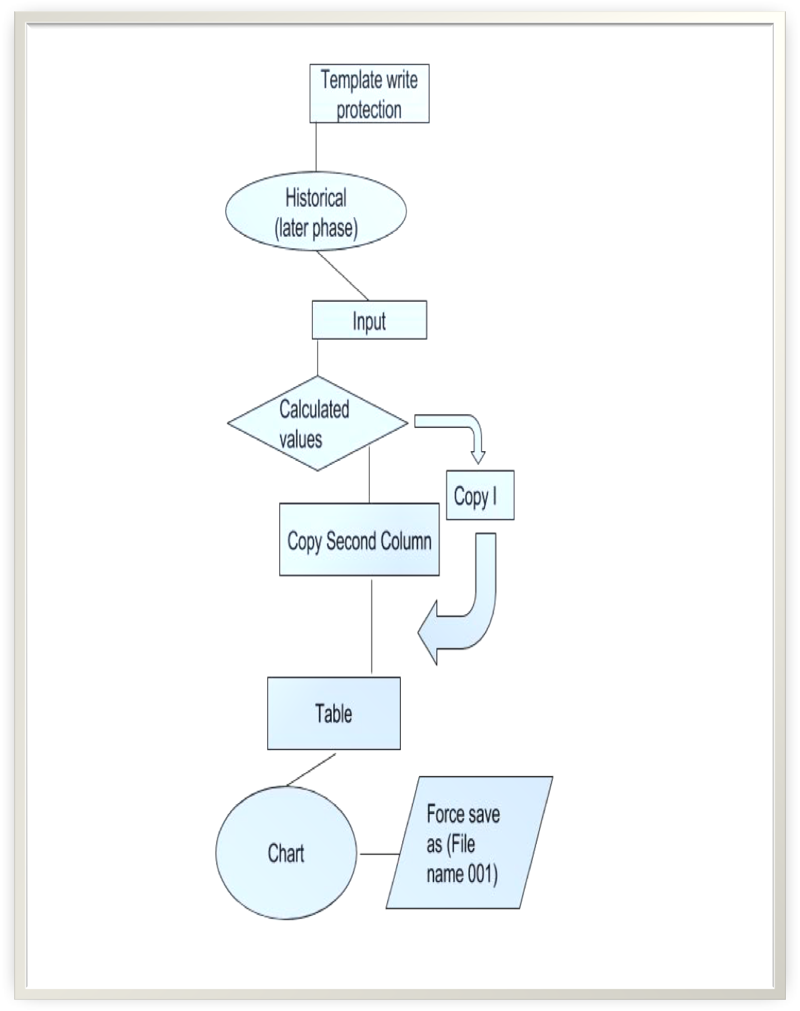
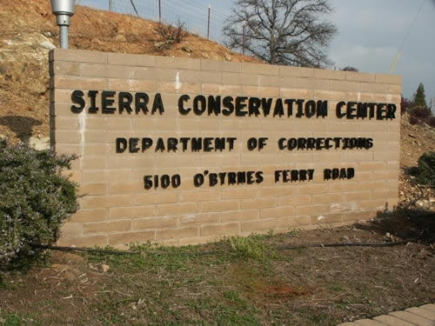
Project Name
Introduction
Methods
Captivated Thinking is creating an Excel Spreadsheet, along with a user manual, hat serves the people of Tuolumne County Economic Development Authority (TCEDA) The spreadsheet will help generate accurate and efficient reports in a timely manner. The team will be collaborating with the Sierra Conservation Center.
TCEDA will spend less resources generating their own reports and have more resources on their reports.
The team has been divided into two primary sub-teams, Assessment Team and the Graph Team.
Future Plans
Charts
Our primary task as of now is to gather complete specifications for the program and create a model interface that will suit the needs of the TCEDA, as will be determined by further communicating with the Director of Economic Development at the TCEDA
We need two more charts from the graph team that will be here. Modify Future Plans to fit what we have in the semester proposal. Methods- just needs to talk about how we get things done.

